Slide 1
Automatic Tide Gauge with
Data logger

Slide 2
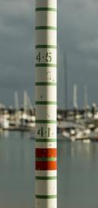
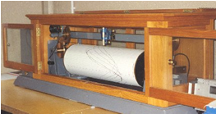
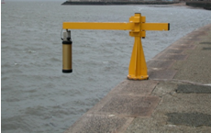
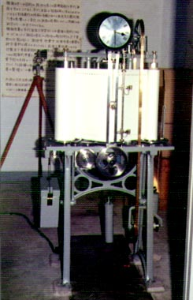
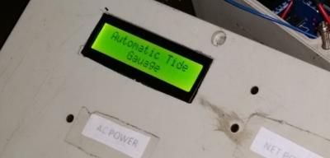
Introduction
Monitoring tide has always been important such as .
Navigating ships safely through shallow water ports.
Calculate Mean sea level and above mean sea level (AMSL).
Sea-level changes can be monitored to spot patterns or unusual behaviour.
Tide gauge technology has advanced considerably over the last few decades and nowadays.
In order to measure long term sea level changes accurately, it is important to ensure that tide gauge instrumentation remains stable over time.
Notes:
1. If we consider the data transmission techniques, we have two basic types.
2. One of them is wired communication and other one is wireless communication.
3. When it is required to transmit data over the long distance, the wired communication is not suitable for that.
4. The solution is wireless communication.
5. Modern day we can see various type of wireless techniques. Specially wireless Digital transmission techniques like RS 232 protocol.
6. But if we talk about analogue data transmission, the radio and TV broadcasting come into our mind directly.
7. Frequency modulation is the major technique which is used for all of these applications.
8. So I selected this FM as my wireless transmission technique.

Slide 3
Objectives
To design a tide gauge which capable to send data automatically to a central database and those data could be access by multiple users. The system capable to self-data logging whenever network not present.
High availability.
Higher accuracy
Central data logging facility.
Low cost
Notes:
Today many applications use ADC and DAC, although they are operated with analogue data.
The main objective is this project, design a system to transmit the analogue data without using of ADC and DAC.
Theoretically this techniques has high resolution.
It is expected high accuracy of the transmitted data.
Respond time is a crucial thing in this type of system. But this system was designed for slow varying data transmission.
Finally It was expected to complete the project with law budget.

Slide 4
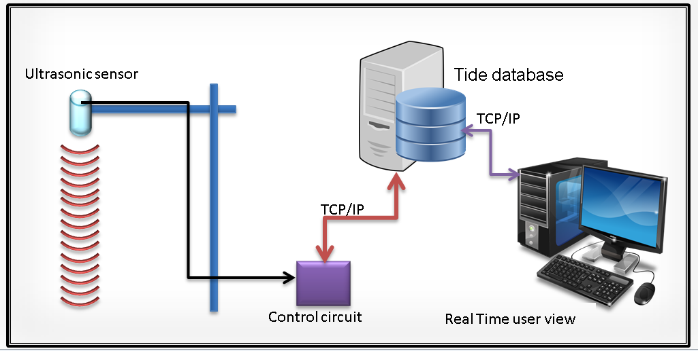
Overall Design
a. Ultrasonic distance sensor:
b. Controller circuit:
I. Calculate water level.
II. Send processed data to the application server.
III. Generate time stamp and save log in micro SD card.
IV. Display results.
c. Application server:
I. Save received information on the database.
II. Generate multiple views (graph, data table)
III. Process data (noise cut off)
d. User terminal:
This can be any device with a web browser which capable to accesses application server.
System overview
Notes:
Lets see the overall design of the system.
Earlier I designed the system with main four circuit. you can see them in the top of the list here. Additionally another sub circuit was constructed with the unexpected issue.
You can have a clear idea about my project with this block diagram.

Slide 5
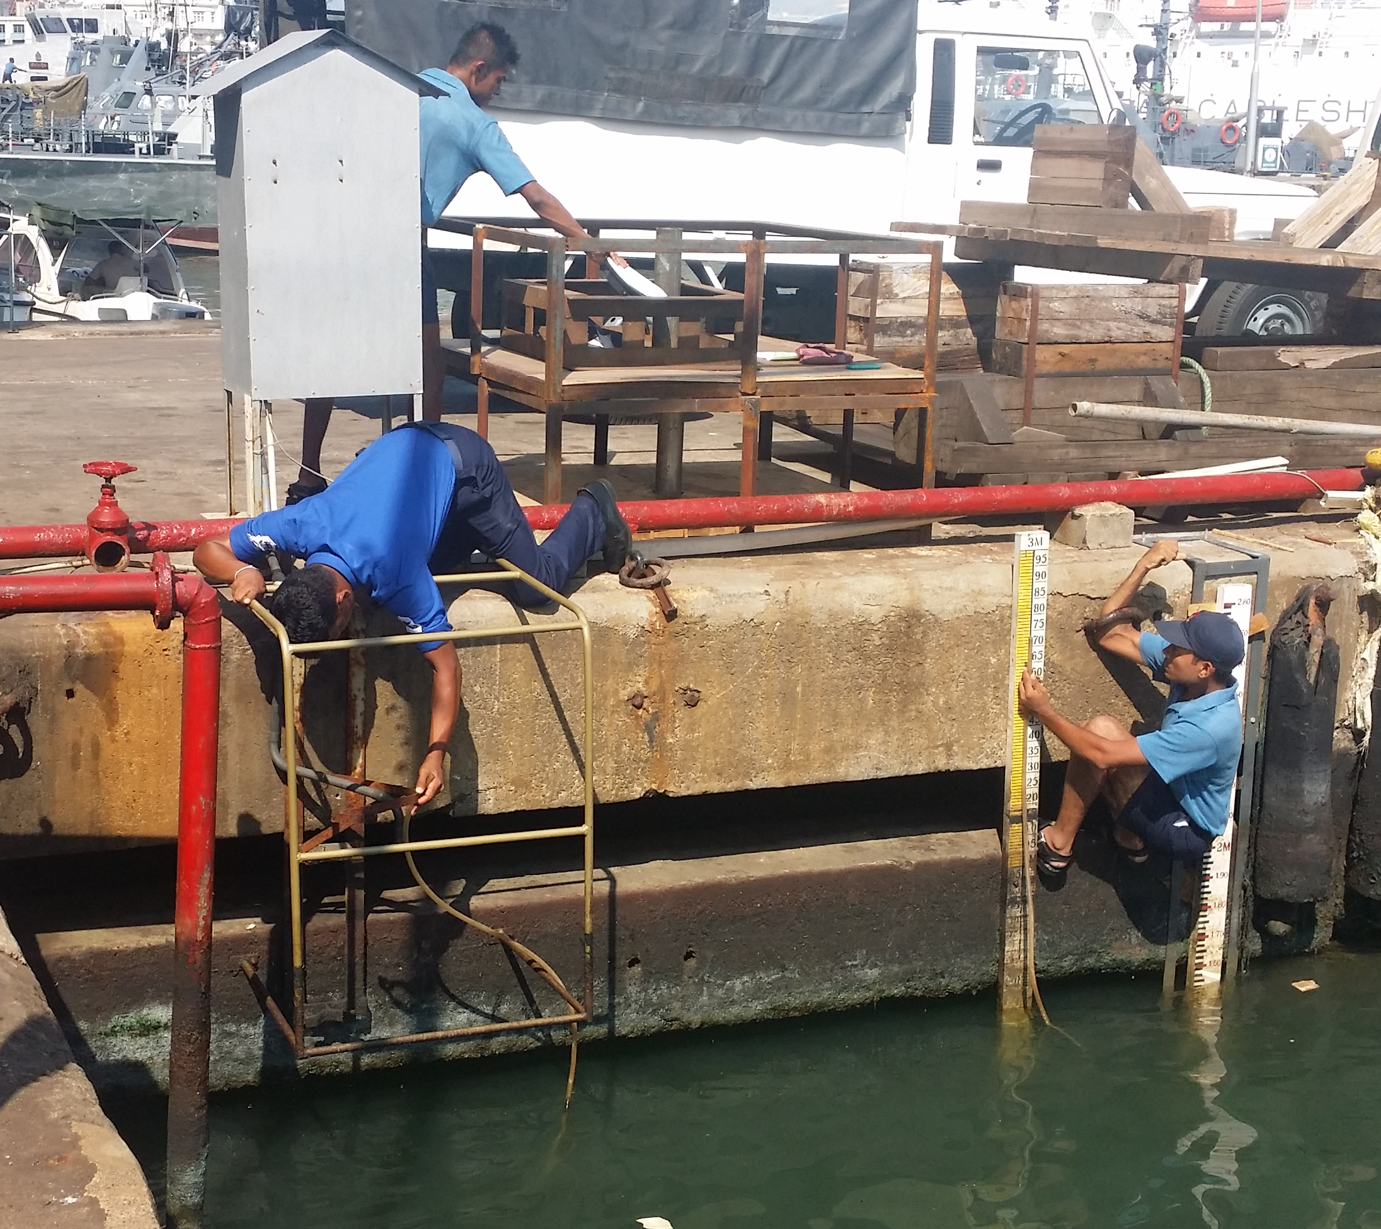
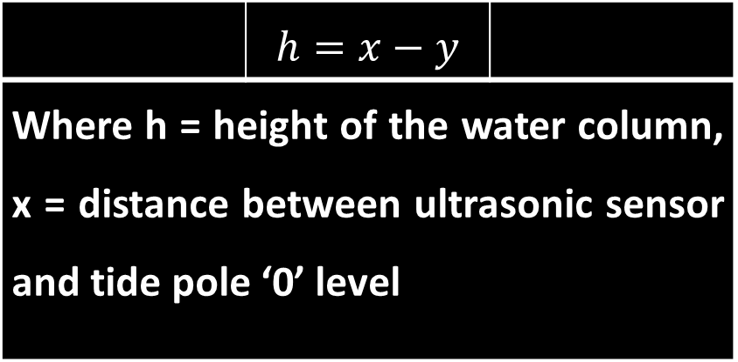
Water column height reference to tide pole
 | $$h=x−y$$
Where h = height of the water column, x = distance between ultrasonic sensor and tide pole ‘0’ level

Slide 6
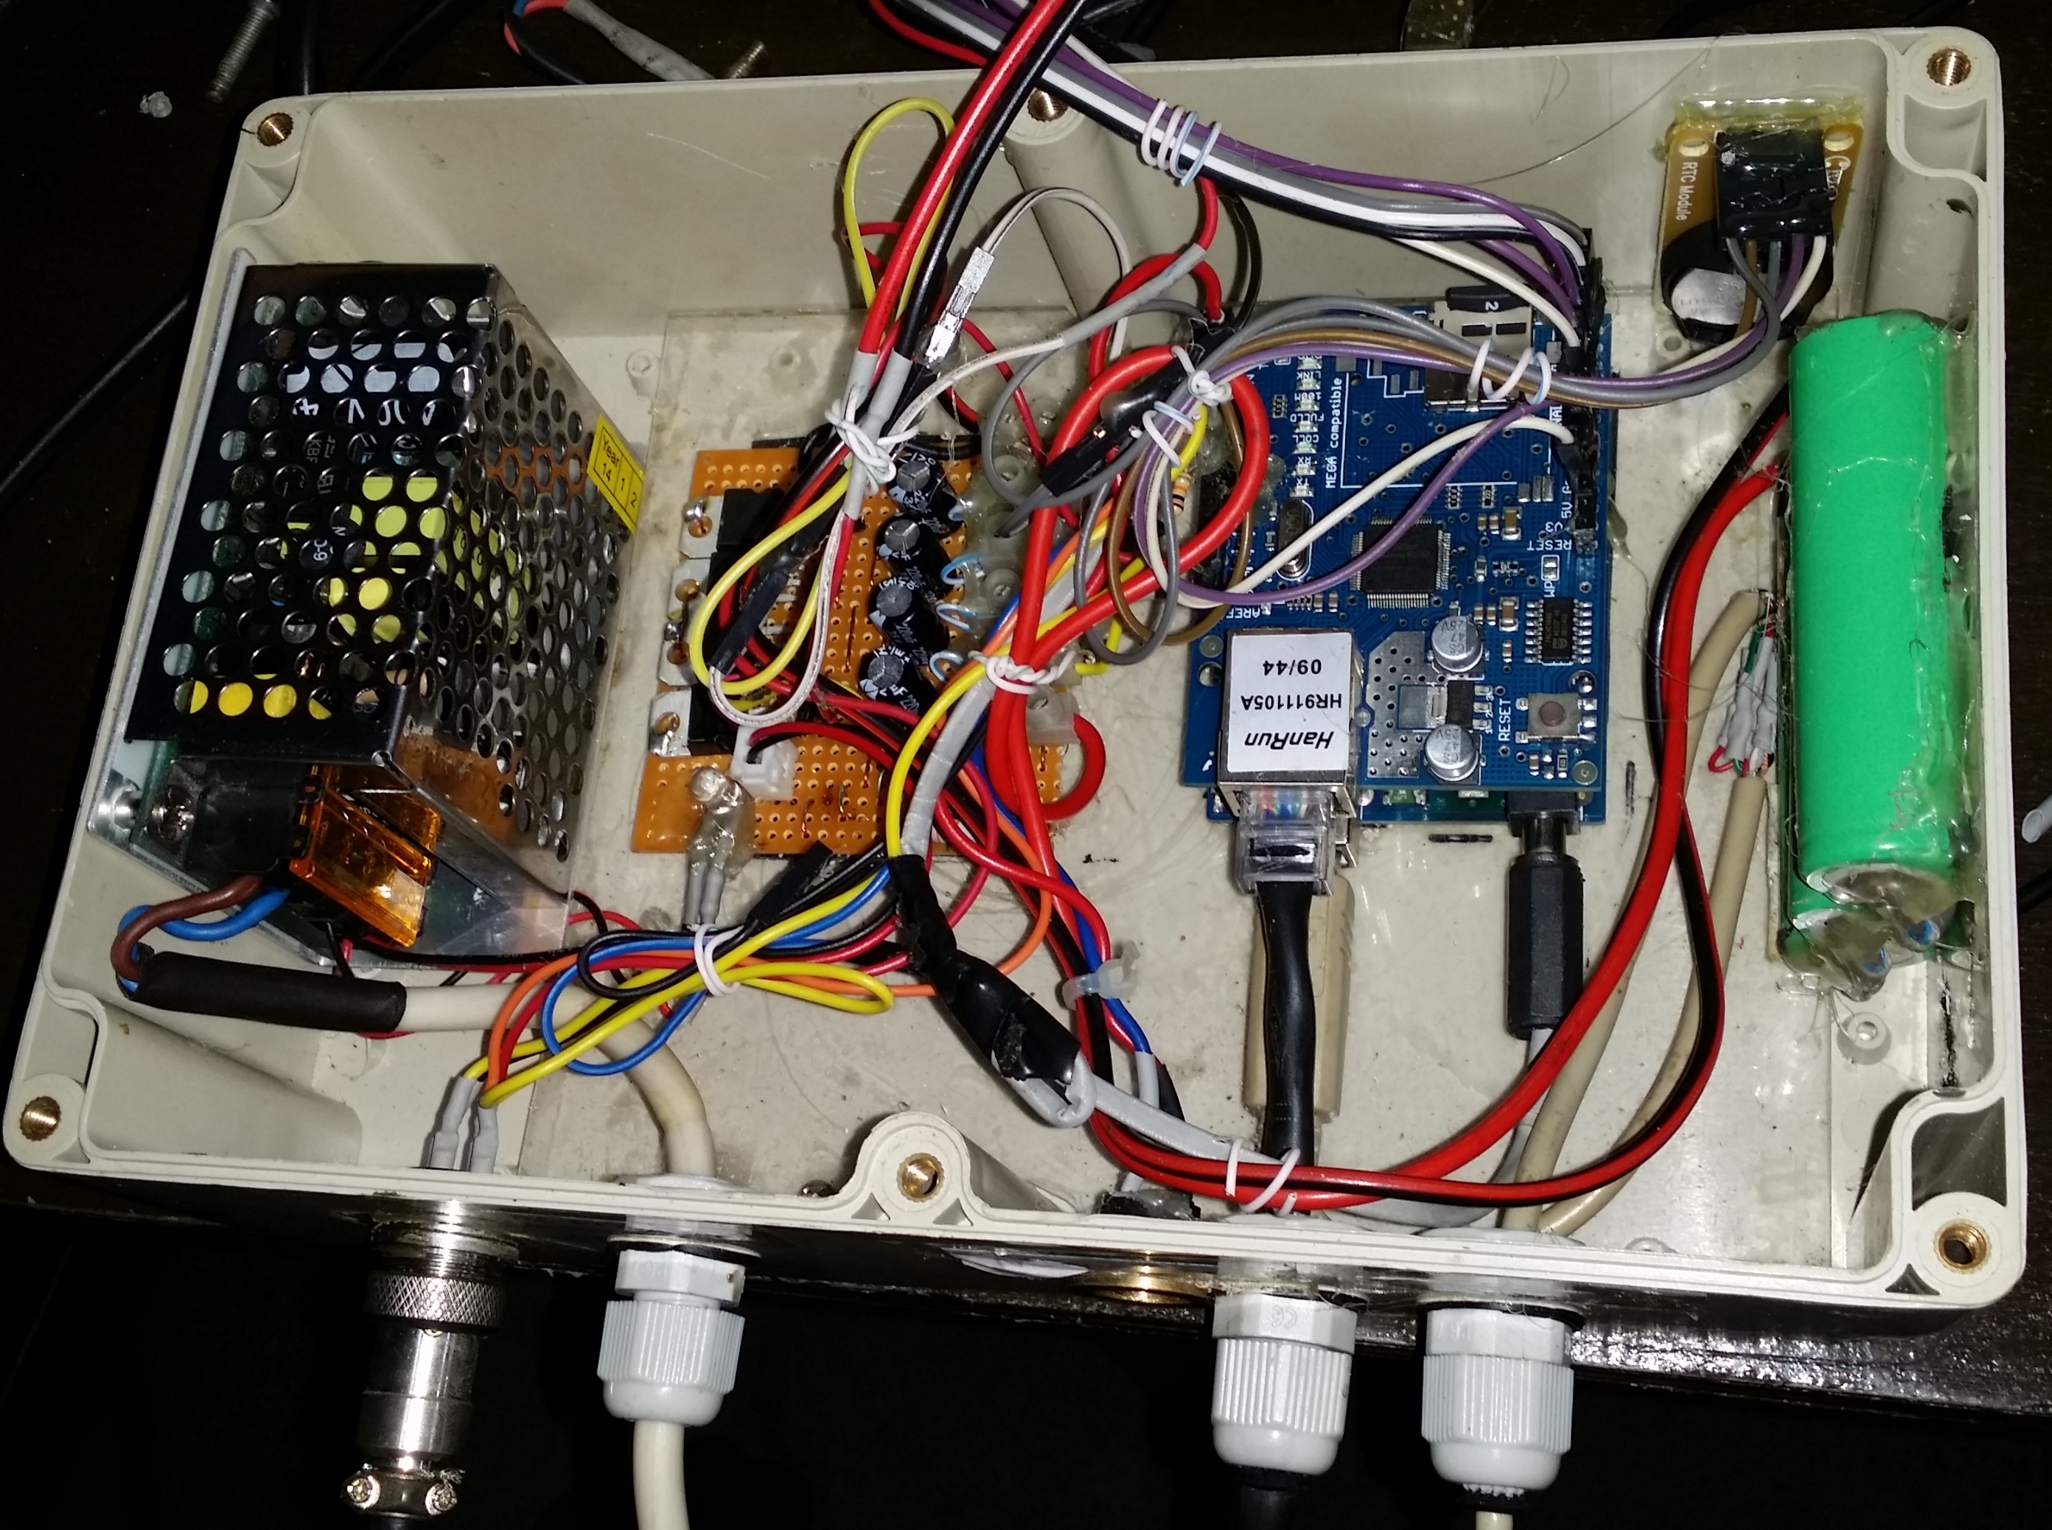
Circuit Design and mount
Power Distribution circuit
RTC Module
Switching Power supply
Back up battery
230V AC IN
Network Shilled
Buzzer
TCP/IP Connection
Ultrasonic Sensor
Connection
USB Debug Port/Serial out

Slide 7
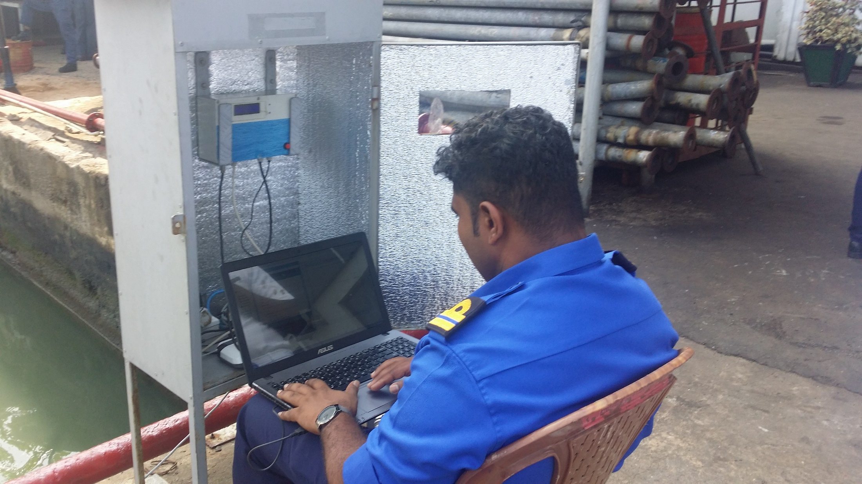
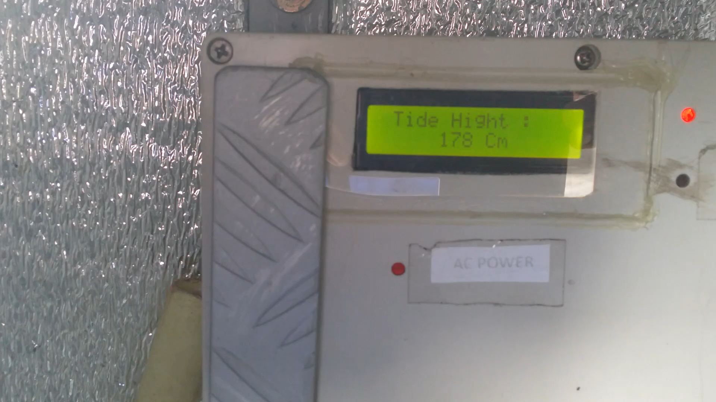
System calibration
Calculate tide Height
Find out suitable number of reading to calculate average Tide height.
Setup resolution of the reading
Calibrated data
Height of the sensor | : 256 Cm
No of reading to calculate average | : 15 S
Duration to process single reading | : 15 S
Duration to send TCP/IP message | : 75 S
Data saving resolution every | : 5 Min

Slide 8
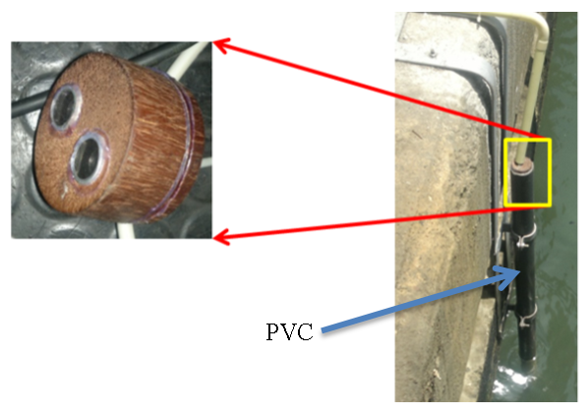
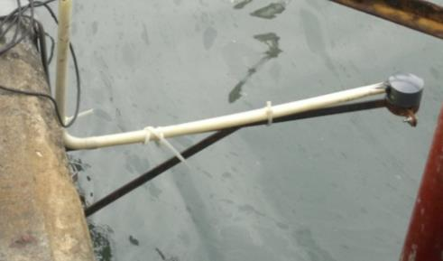
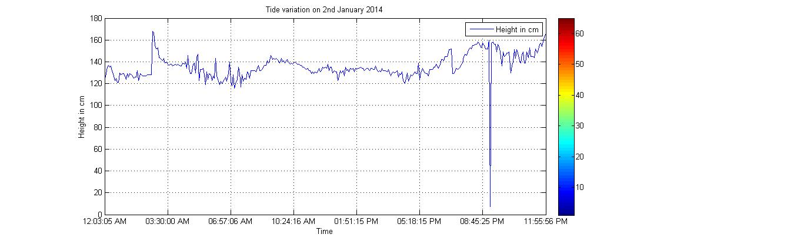
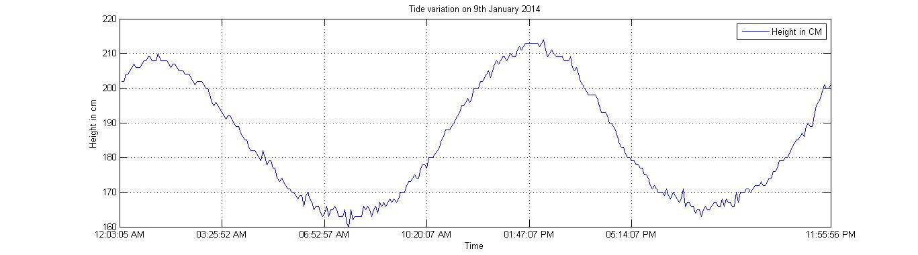
Sensor mount modification
Notes:
When it is ON, it generates a unique signal by modulating the information in the signal with the carrier signal corresponding to the amplitude of the signal and then transmits the modulated signal.
Therefore, the ON and OFF state of the transmitter is equal to the frequency of the input square wave.

Slide 9
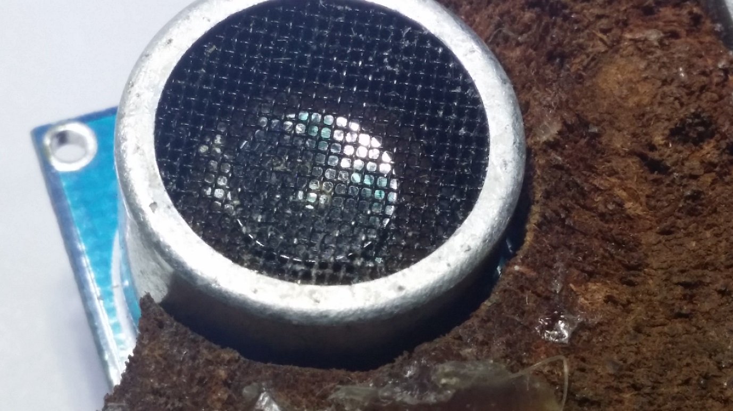
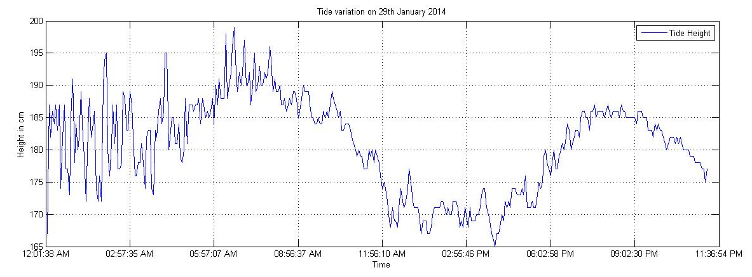
Sensor corrosion due to sea fret
The Sensor has been corrode due to sea fret
Reading was not accurate
Sensor has corrode

Slide 10
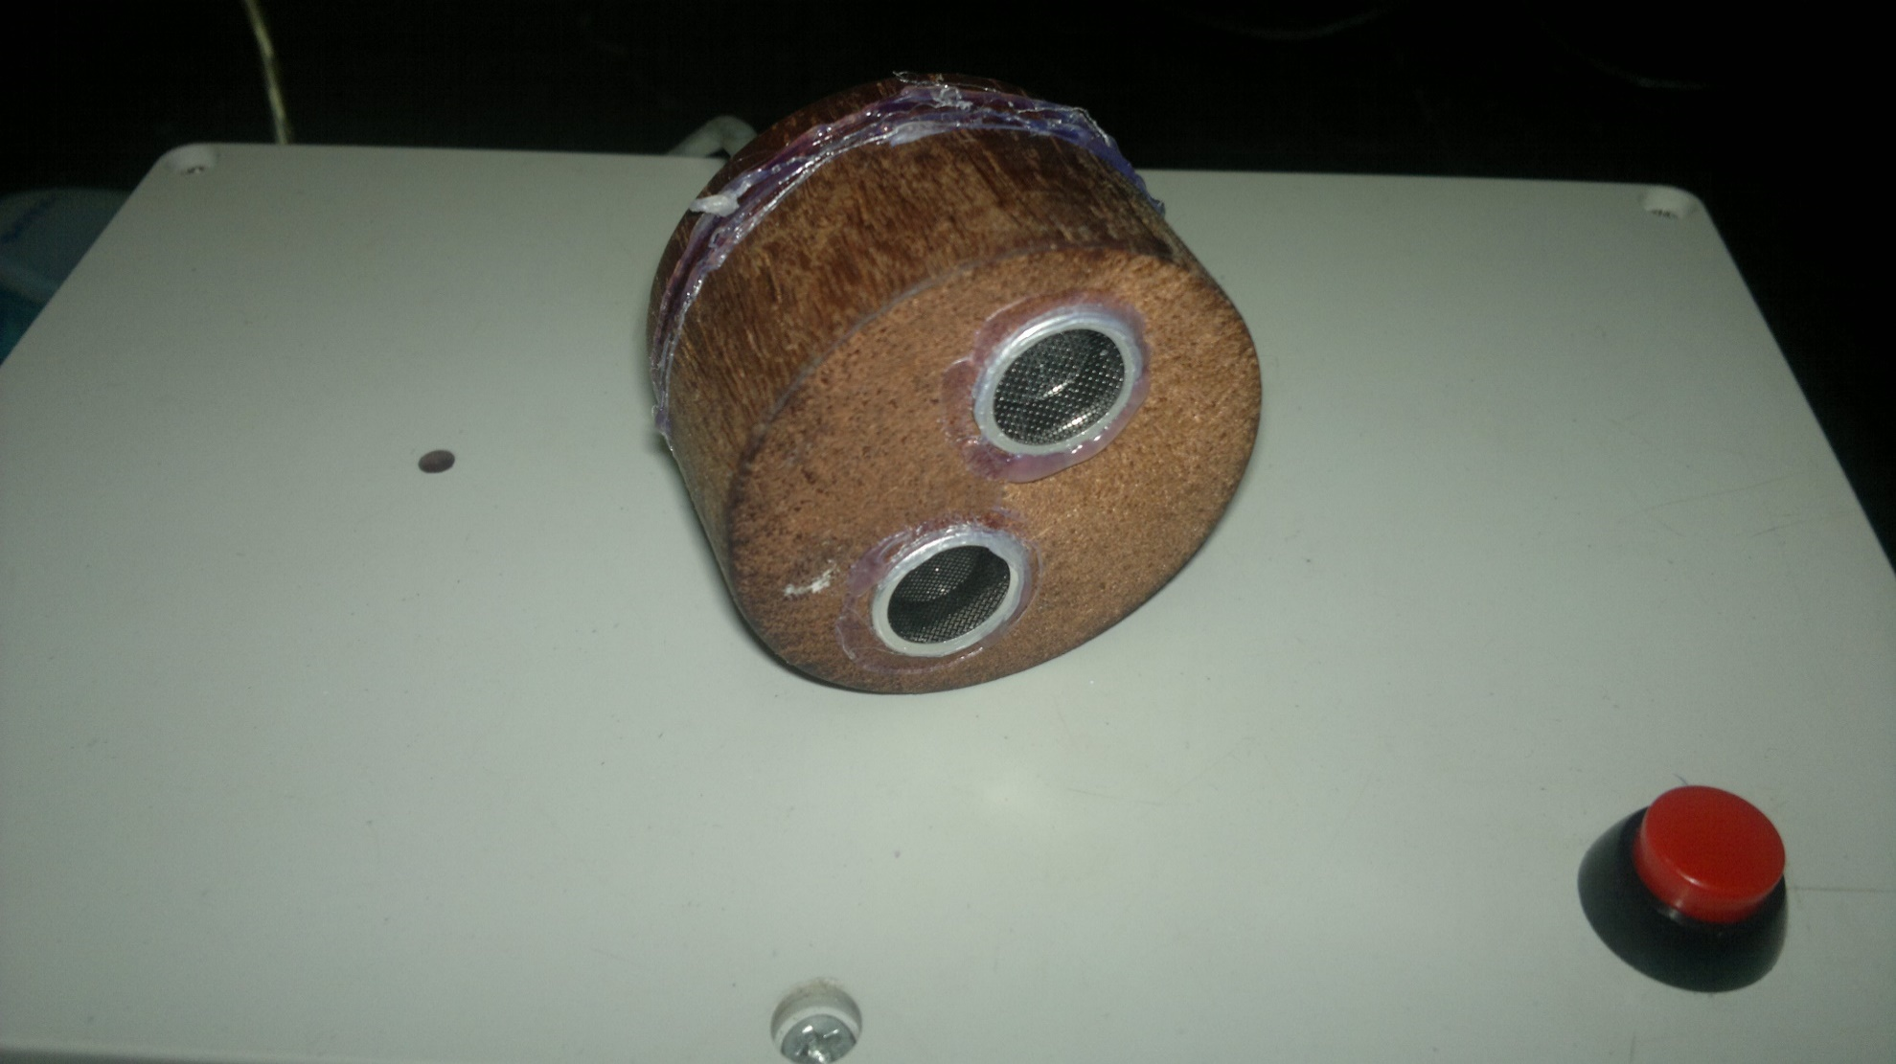
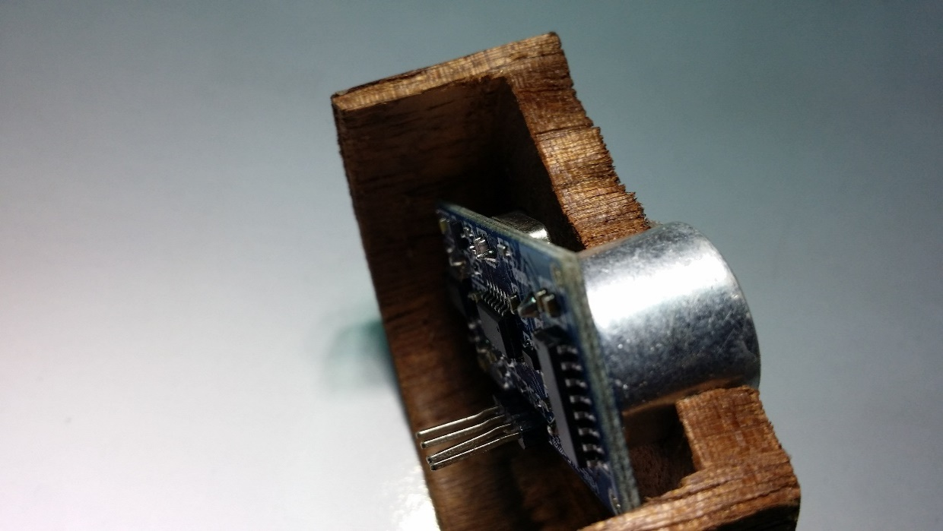
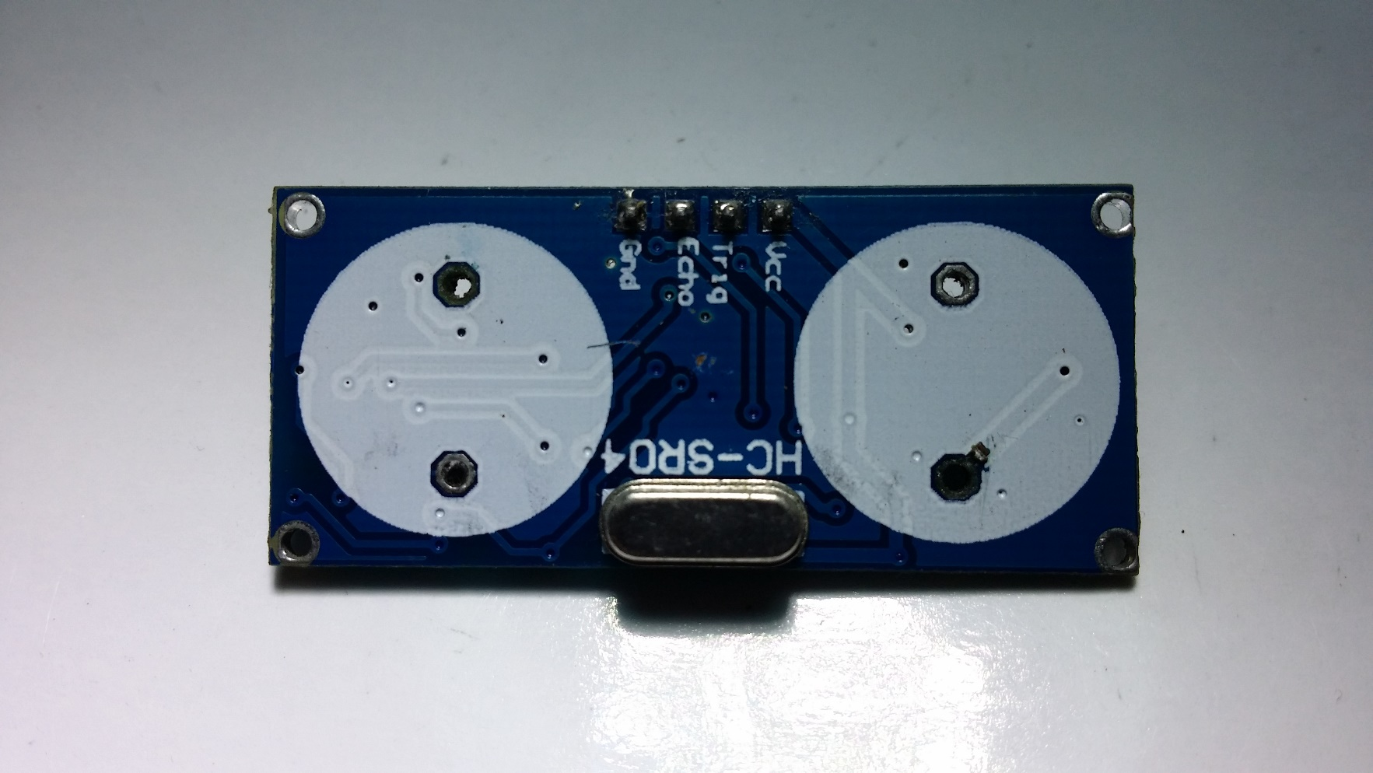
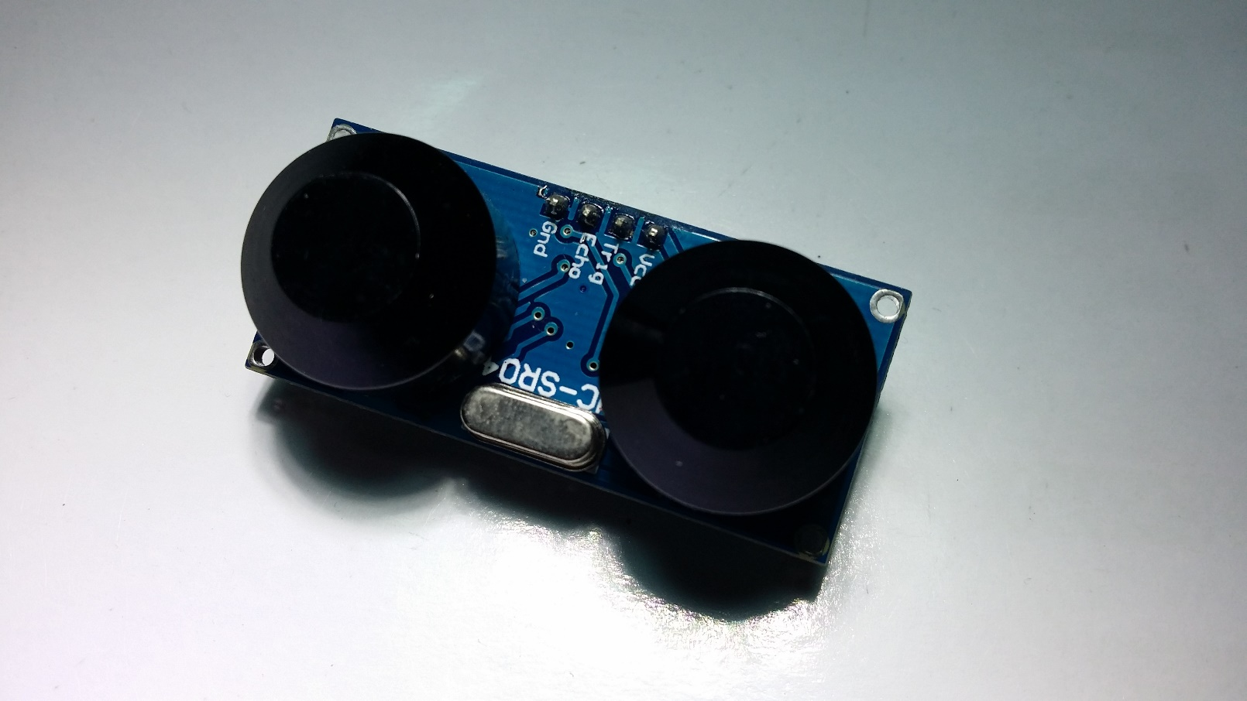
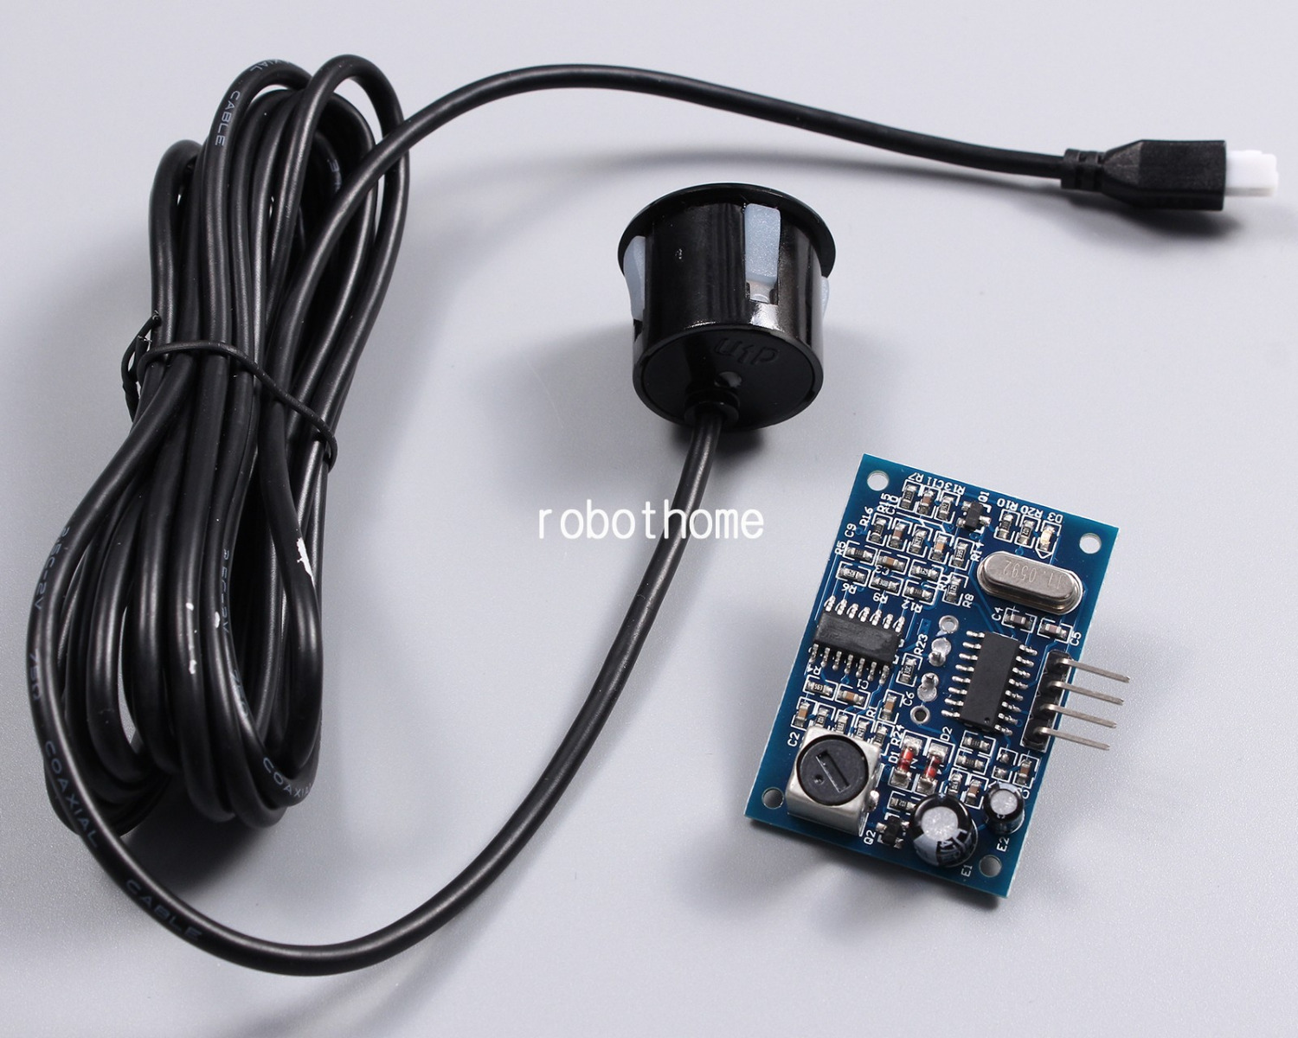

Sensor modification
Notes:
I told you, the transmission unit has two sub systems. First one is VFC. It convert the given voltage into the frequency of output signal. The output wave form is rectangular one.
Newly I have introduced a small modification to improve the input voltage range. It was success and now the VFC can operate over the range of 0 – 10.4 V with having a great linearity.
FM transmitter is used to modulate the signal and transmit this modulated signal in the radio frequency range of 88-108MHz.
This photo shows how I assembled the circuit into the transmitted unit.

Slide 11
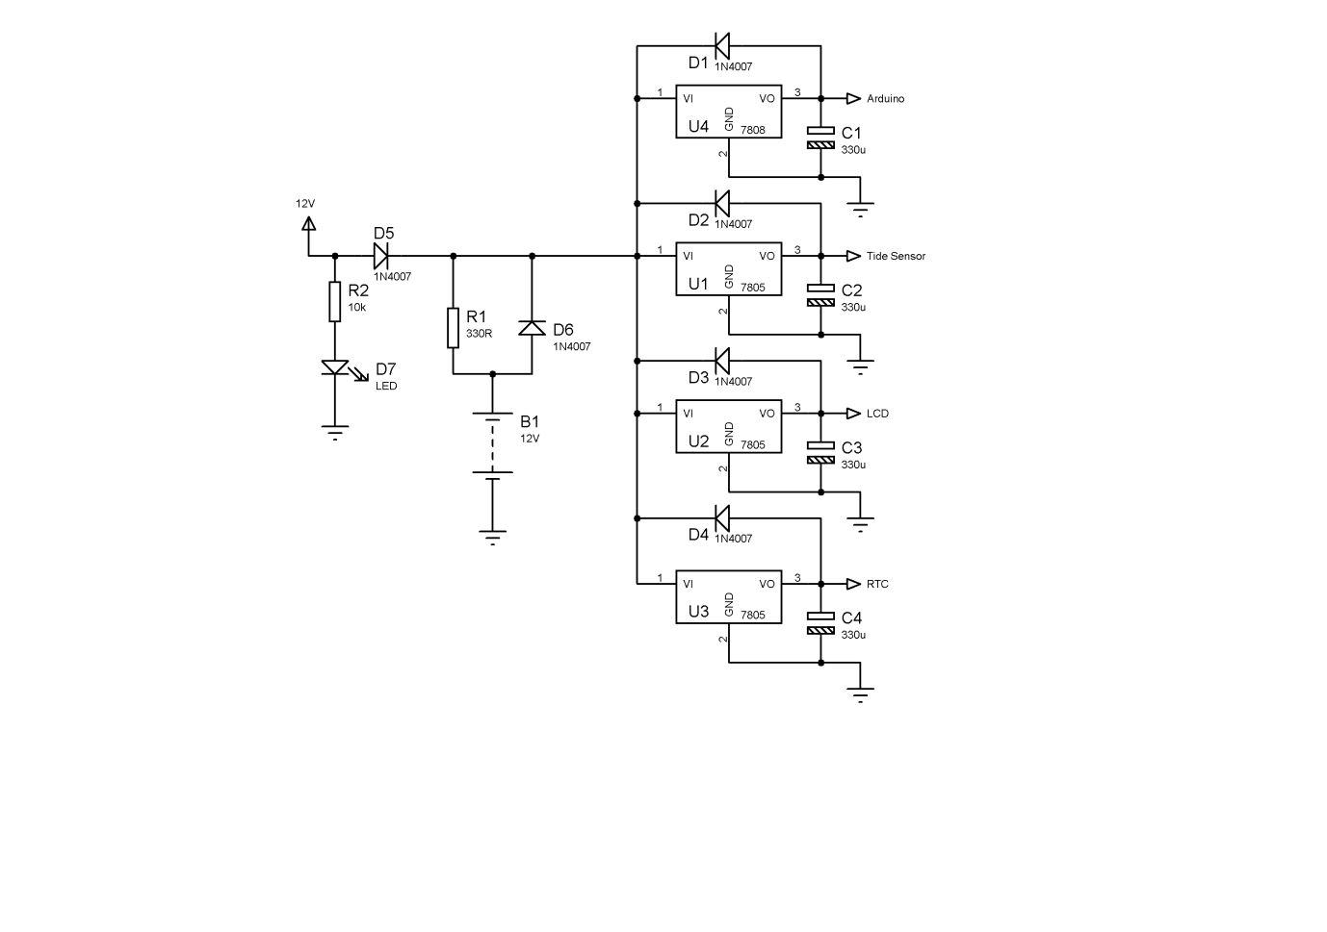
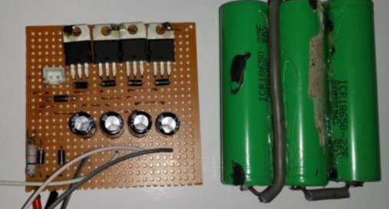
Power consumption
Power consumption component
Ultrasonic Sensor | : 250mA
Ardino Uno module With Network shilled | : 300mA
RTC module | : 50mA
Total | : 600mA
Notes:
1. Curve fitting line in red.
These are the evidences about the Strong linearity of the VFC.
How much fit the data to the fitted line.
How much strong the relationship between Vin and Fout

Slide 12
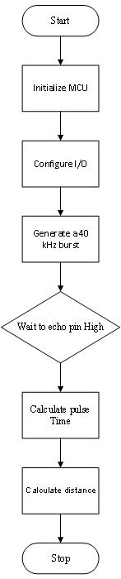
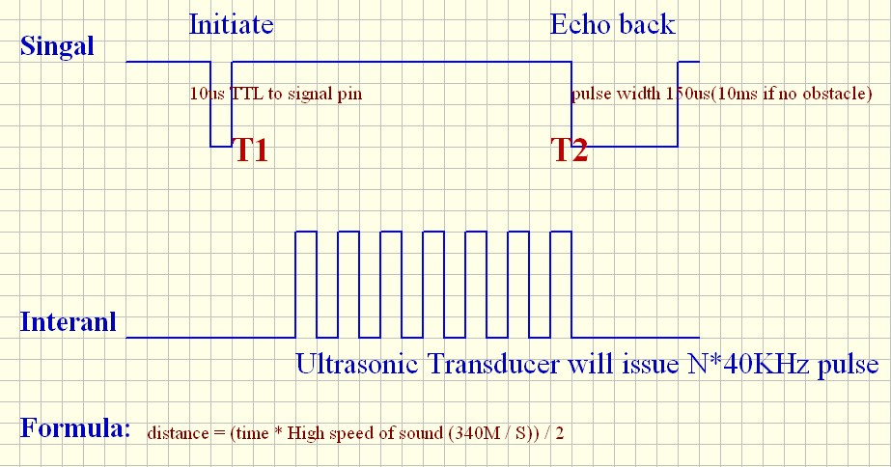
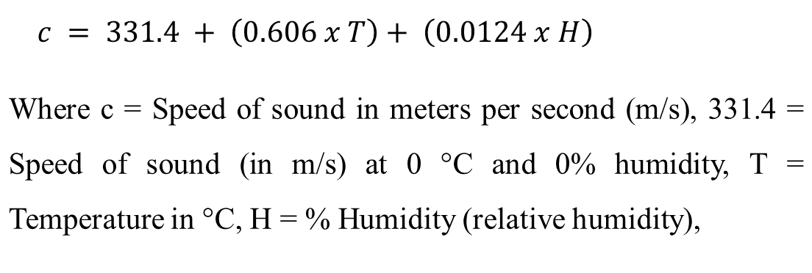
Distance calculation (ultrasonic module)
 | $$c = 331.4 + \left(0.606 x T\right)+ \left(0.0124 x H\right)$$
Where c = Speed of sound in meters per second (m/s), 331.4 = Speed of sound (in m/s) at 0 °C and 0% humidity, T = Temperature in °C, H = % Humidity (relative humidity),
Notes:
This the performance of the FVC. You can see the curve fitting line in red also here.
This was also saw a great linearity. These are the evidence for that.

Slide 13
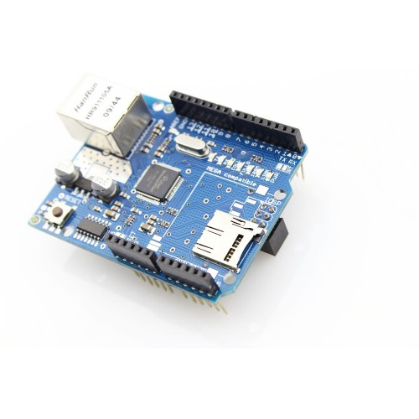
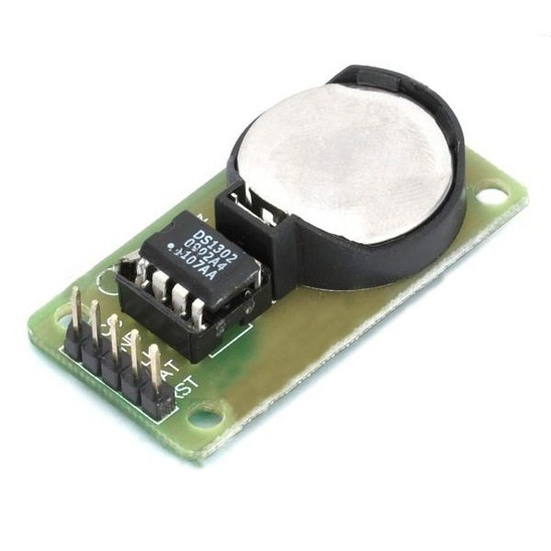
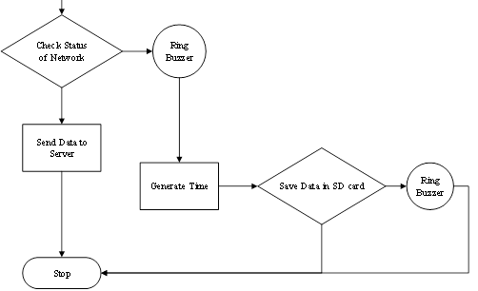
Data Logging
RTC Module
SD CARD Slot
Notes:
This the performance of the FVC. You can see the curve fitting line in red also here.
This was also saw a great linearity. These are the evidence for that.

Slide 14
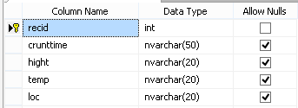
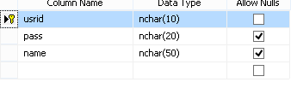
Web application Development- Data base
The Database has design with two tables
Tide Info
Tide Height.
Temperature.
Location Id.
User
User Name.
Password.
Notes:
1. Here you can see how the circuits were placed in the receiver unit.

Slide 15
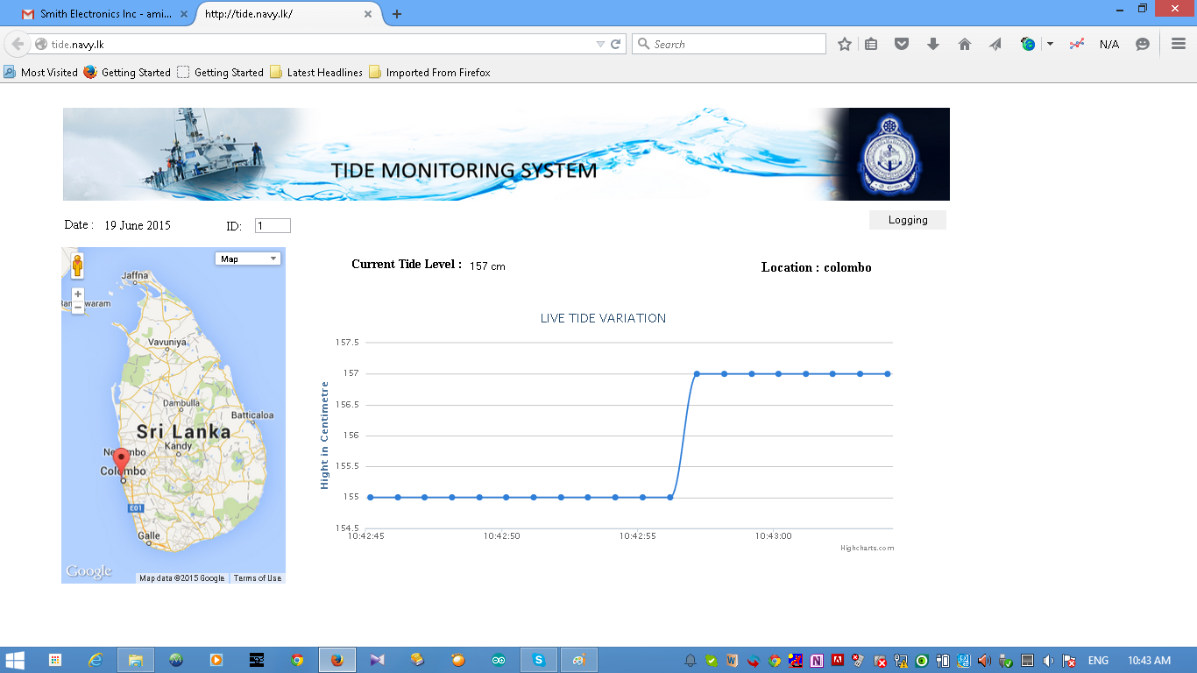
Web application Development- Interface

Slide 16
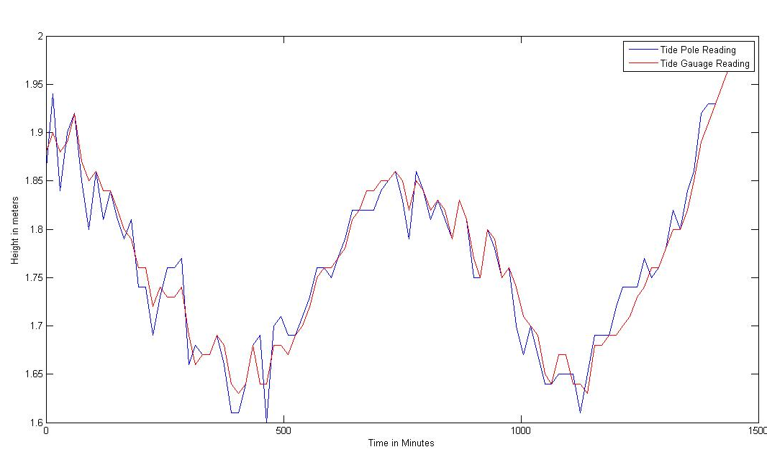
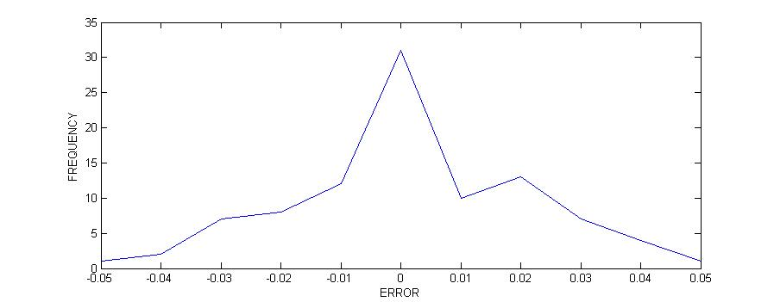
Observation-Comparison with manual data
Manual reading Vs Tide gauge reading in 10/12/2014
Frequency curve of error
ERROR | FREQUENCY
-0.050 | 1
-0.040 | 2
-0.030 | 7
-0.020 | 8
-0.010 | 12
0.000 | 31
0.010 | 10
0.020 | 13
0.030 | 7
0.040 | 4
0.050 | 1
Difference
Mean | 0.001340206
Standard Error | 0.00198593
Median | 0
Mode | 0

Slide 17
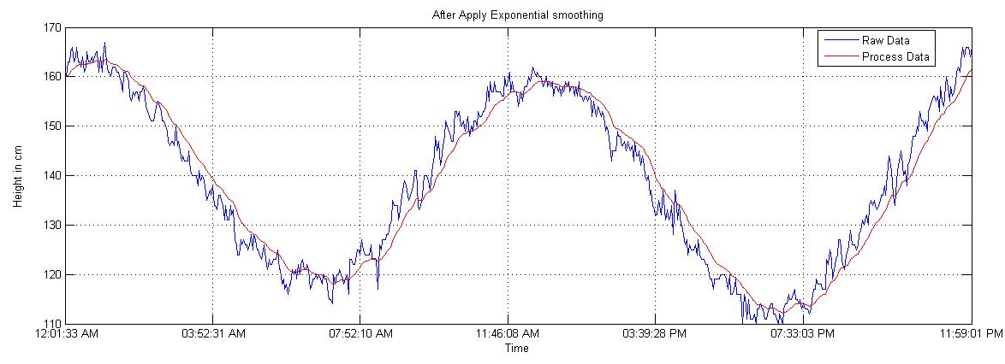
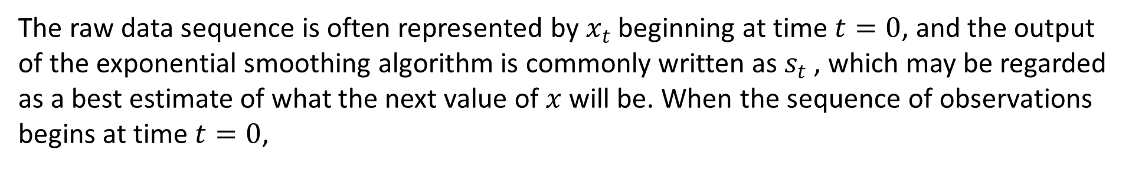
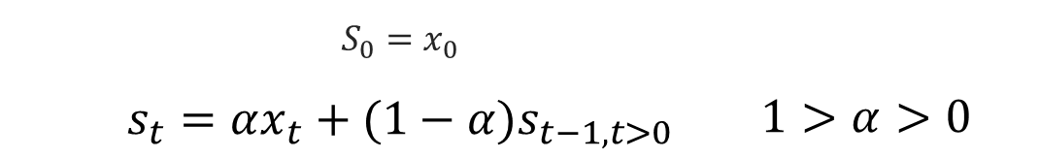
Calculation- Exponential smoothing
 | $$S_{0}=x_{0}$$
 | $$s_{t}=αx_{t}+(1−α)s_{t−1, t>0}$$ | $$1>α>0$$
The raw data sequence is often represented by $x_{t}$ beginning at time $t=0$, and the output of the exponential smoothing algorithm is commonly written as $s_{t}$ , which may be regarded as a best estimate of what the next value of $x$ will be. When the sequence of observations begins at time $t=0$,
Notes:
This the performance of the FVC. You can see the curve fitting line in red also here.
This was also saw a great linearity. These are the evidence for that.

Slide 18
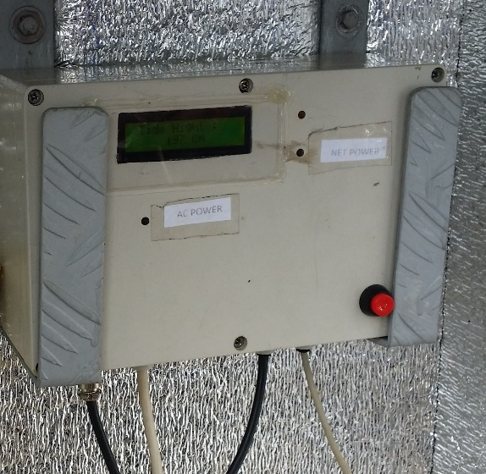
Comparison
Parameter or feature | Web based tide monitoring system(WTM) | Vale port’s mini tide gauge (VTG)
Data logging | Internal memory and central database, | Internal memory only
Monitoring | Web application real time (multiple locations) | Windows base pc software (only one location at a time)
Electrical | Ac power source with battery backup, Battery backup up to 4 hrs Current: 200mA | 30 days (alkaline) @ 40 secs / 10 mins 80 days (lithium) @ 40 secs / 10 mins
Communication | TCP/IP: 100m to switch USB: debug and serial interface | RS232: Up to 200m cable, direct to serial port RS485: Up to 1000m cable Baud Rate: 4800

Slide 19
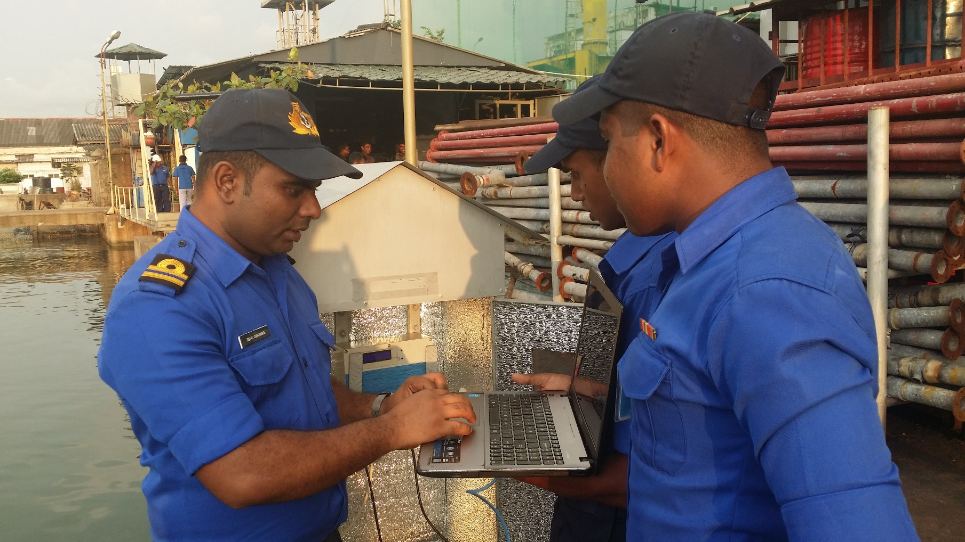
Conclusion
This research was performed due to the requirement of hydrography unit. They manually monitor tilde variation since 2013 and they need huge human power to monitor it manually also there are systems available in the market SLN got a quotation from one system around 18 Million LKR which is highly costly and it doesn’t have central monitoring facility and data store facility which was included in my research.

Slide 20
Future plan
As discuss on system failure section the system can be improved from following areas.
Connection:
TCP/IP .
GSM/GPRS/SMS
Power:
Battery backup.
Solar power.
Web application:
A/C power status notification.
Data prediction.
Sensor:
Ultrasonic Sensor.
Temperature sensor.

Slide 21
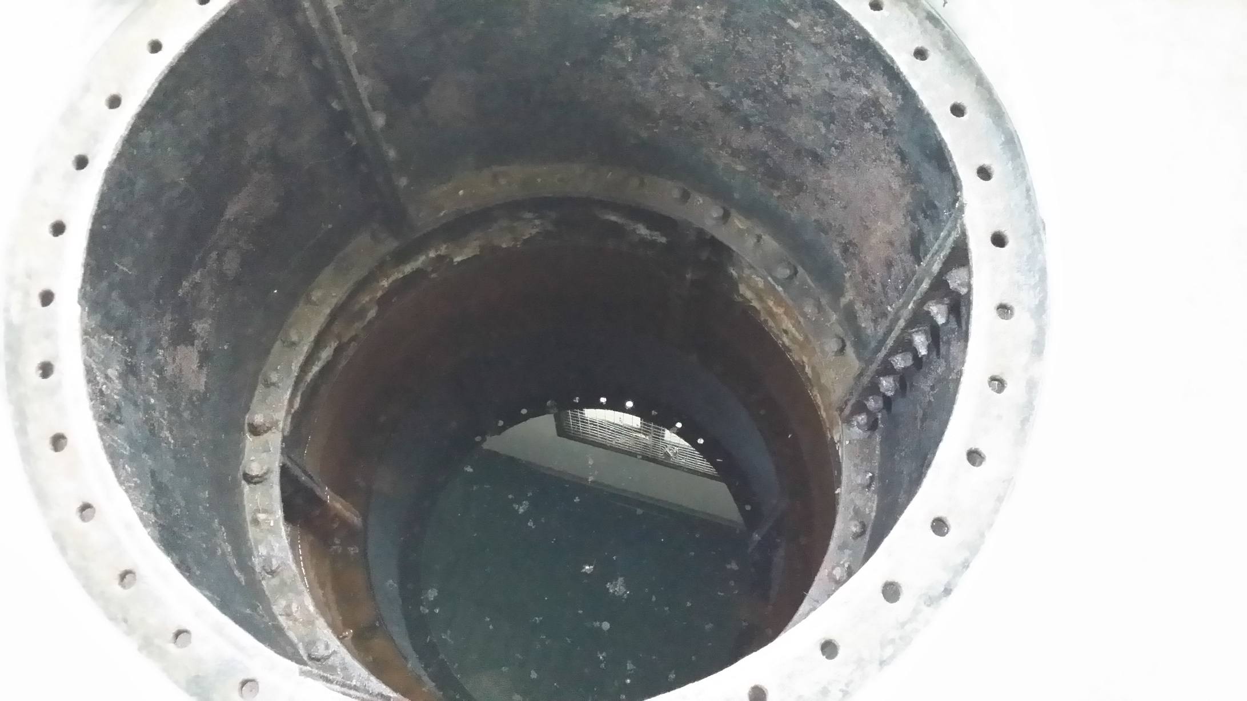

Future plan
Install New tide gauge in Trincomalee
The next tide gauge plan to install in Trincomalee tide well . The tide well establish in 1922 in trincomalee by British navy

Slide 22
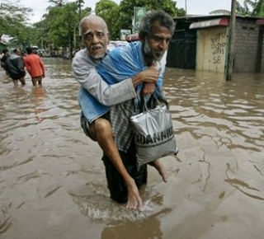
Possible system extensions
This system can be easily transferred to flood monitoring in certain areas in Sri Lanka. And eagerly waiting for extend the system.
This system can use for detecting tsunami and sea condition by detecting height fluctuation .
Specially system can be modify to monitor water level of reviver

Slide 23
Thank you!!

